Slide 1
Hellenic Statistical Authority (ELSTAT)
Christina Pierrakou – Eleni Bisioti
ELSTAT – 5.10.2018
Conference Smart Statistics4Smart Cities 5-6 October, Kalamata

Slide 2
Overview
Introduction
Automatic Identification System (AIS)
Define ship’s journey
Visualization
Next Steps
AIS meets IoT
Conference Smart Statistics4Smart Cities 5-6 October, Kalamata

Slide 3
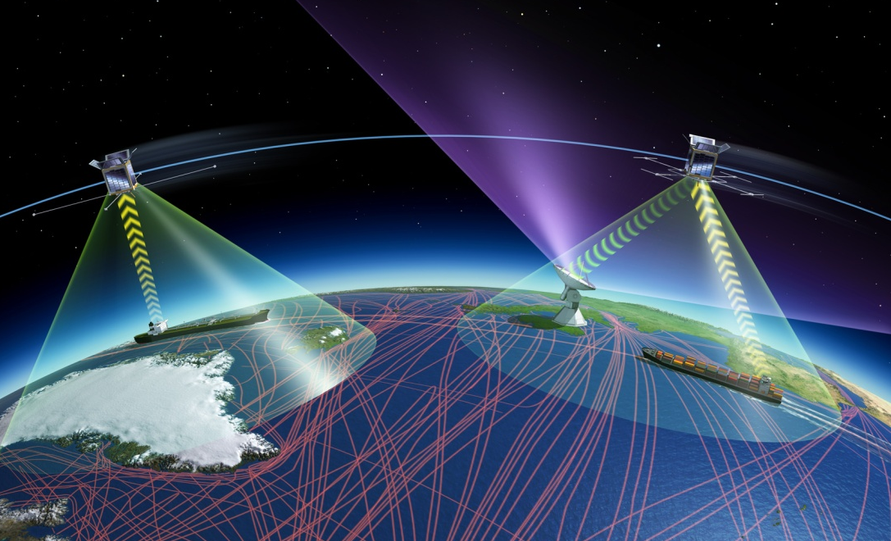
Introduction
Research on the use of AIS data for official statistics was part of the ESSnet Big Data project, performed by The Netherlands (Work package leader), Greece, Poland, Norway and Denmark.
Image source: http://www.esa.int/Our_Activities/Telecommunications_Integrated_Applications/SAT-AIS_for_maritime
Conference Smart Statistics4Smart Cities 5-6 October, Kalamata

Slide 4
Conference Smart Statistics4Smart Cities 5-6 October, Kalamata

Slide 5
Automatic Identification System (AIS)
The AIS is an international ship identification standard that allows vessels to transmit and receive information in the immediate vicinity. AIS data comprised of 3 information categories:
Dynamic: information on ship movements [Ship’s position (long, lat), speed over ground (SOG), course over ground (COG), navigation status]
Voyage related: information on current voyage (destination, estimated time of arrival, draught)
Time does not exist in AIS frames. It is added by receivers
Static: information on ship characteristics (MMSI, IMO number, call sign, ship name , type, dimensions)
MMSI - Ship’s unique identification system
GPS data to record and track position
VHF radio signals for receiving and sending AIS information
Conference Smart Statistics4Smart Cities 5-6 October, Kalamata

Slide 6
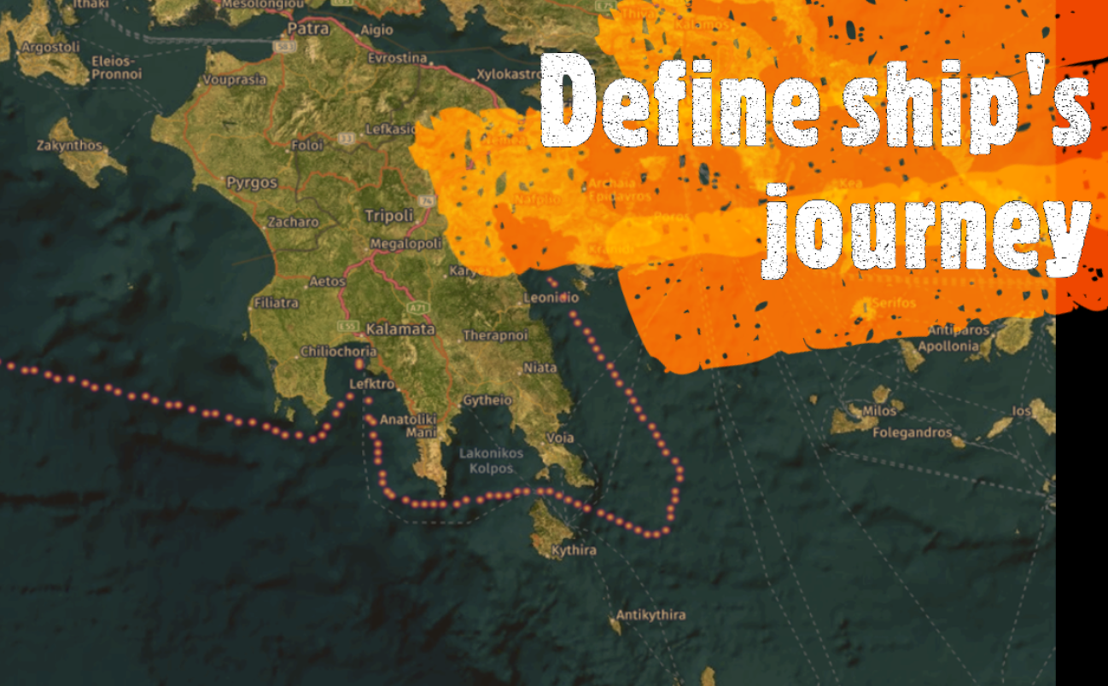
Conference Smart Statistics4Smart Cities 5-6 October, Kalamata

Slide 7
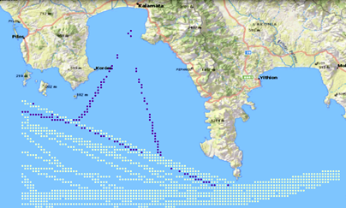
Define ship’s journey
Raw AIS Data
Data ready for spatio-temporal analysis
Decoding AIS Importing in a spatio-temp database
Cleaning/Filtering Vessel POINTS GIS layer
LINES GIS layer Data matching
Conference Smart Statistics4Smart Cities 5-6 October, Kalamata

Slide 8
Conference Smart Statistics4Smart Cities 5-6 October, Kalamata

Slide 9
Conference Smart Statistics4Smart Cities 5-6 October, Kalamata

Slide 10
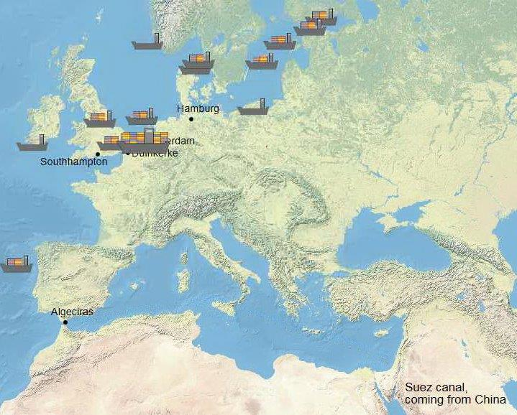
Visualization (2/3)
Source: Research site of Statistics Netherlands: http://research.cbs.nl/AIS_transshipment
Conference Smart Statistics4Smart Cities 5-6 October, Kalamata

Slide 11
Visualization (3/3)
Conference Smart Statistics4Smart Cities 5-6 October, Kalamata

Slide 12
Benefits - Challenges from the use of AIS data
Benefits
enhance timeliness and accessibility
reduce the response burden of ports authorities and agencies
determine the impact of maritime legislation at national and European level
improve statistics (e.g., vessel movement statistics between European countries, such as port visits, and route trajectories)
Challenges
technical challenges
building of capacities to handle AIS data by NSIs
Conference Smart Statistics4Smart Cities 5-6 October, Kalamata

Slide 13
Conference Smart Statistics4Smart Cities 5-6 October, Kalamata

Slide 14
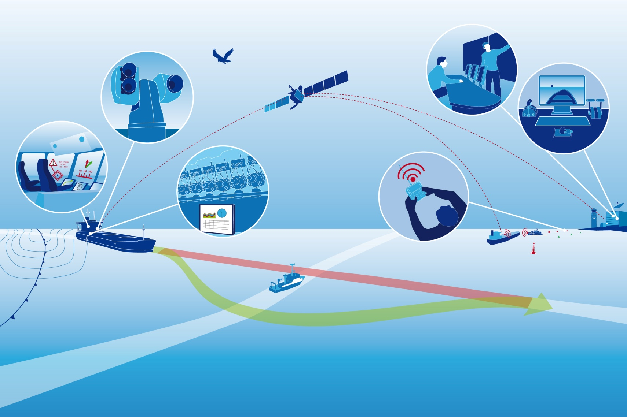
AIS meets IoT (1/2)
Image source: http://articles.maritimepropulsion.com/article/Ghost-ships-on-the-Oceans-Who-says-it-doesnt-work-Part-220685.aspx
Conference Smart Statistics4Smart Cities 5-6 October, Kalamata

Slide 15
AIS meets IoT (2/2)
Image source: http://www.marinemec.com/news/view,iot-at-sea-will-revolutionise-global-supply-chains_49068.htm
Conference Smart Statistics4Smart Cities 5-6 October, Kalamata

Slide 16
Conference Smart Statistics4Smart Cities 5-6 October, Kalamata

Slide 17
Next Steps
New ESSnet project starts end 2018
Research topics:
Reference frame of ports
Further improve of port to port distance matrix
AIS as a fast economic indicator
Combining AIS with other data to provide more detailed information (e.g. on the type and capacity of ships)
Anomalies in the movements of ships
Conference Smart Statistics4Smart Cities 5-6 October, Kalamata

Slide 18
Tracking ships using AIS data – An example in area of Kalamata
More information:
Wiki: https://webgate.ec.europa.eu/fpfis/mwikis/essnetbigdata/index.php/WP4
Github: https://github.com/mputs/WP4/locations
Thank you!
Questions?
Christina Pierrakou, ELSTAT Greece, c.pierrakou@statistics.gr
Eleni Bisioti, ELSTAT Greece, e.bisioti@statistics.gr
Conference Smart Statistics4Smart Cities 5-6 October, Kalamata

Slide 19
References
 | Reference | Retrieved from
1 | Fiorini, M. Capata, A. and Bloisi, D. (2016) AIS Data Visualization for Maritime Spatial Planning (MSP). International Journal of e-Navigation and Maritime Economy, 45-60 | https://www.sciencedirect.com/science/article/pii/S2405535216300201
2 | Powell St. (2017) AIS Meets IoT . How Technology is set to Transform Global Ocean Trade and Supply Chain Efficiency, The Maritime Executive | https://www.maritime-executive.com/editorials/ais-meets-iot#gs.FlZPvzs
3 | Le Tixerant M., Le Guyader D., Gourmelon F., Queffelec B (2018) How can Automatic Identification System (AIS) data be used for maritime spatial planning? | https://marxiv.org/4sfcd/
4 | Marine Management Organisation (2014) Mapping UK shipping density and routes from AIS. | https://assets.publishing.service.gov.uk/government/uploads/system/uploads/attachment_data/file/317770/1066.pdf
5 | T. de Wit, A. Consten, M. Puts, Ch. Pierrakou, M. Bis, A. Bilska, O. Grøndal, Ø. Langsrud (2017). Deliverable 4.2: Deriving port visits and linking data from Maritime statistics with AIS-data. | https://webgate.ec.europa.eu/fpfis/mwikis/essnetbigdata/images/8/8d/WP4_Deliverable_4.2_2017_02_10.pdf
6 | M. Puts, O. Grøndal, M. Pouwels, A. Consten, Ch. Pierrakou, O. Langsrud (2016) Deliverable 4.1: Creating a database with AIS data for official statistics: possibilities and pitfalls | https://webgate.ec.europa.eu/fpfis/mwikis/essnetbigdata/images/1/18/WP4_Deliverable_4.1_2016_07_28.pdf
7 | A. Consten, M. Puts, T. de Wit, E. Bisioti, Ch. Pierrakou, A. Bilska, M. Bis, Ø. Langsrud (2018). Deliverable 4.8: Consolidated report on project results including a cost-benefit analysis of using AIS-data for official statistics. | https://webgate.ec.europa.eu/fpfis/mwikis/essnetbigdata/images/3/3f/WP4_Deliverable_4.8_31_05_2018_final.pdf
8 | A. Consten, M. Puts, T. de Wit, E. Bisioti, Ch. Pierrakou, A. Bilska, M. Bis, O. Grøndal, Ø. Langsrud (2017). Deliverable 4.3: Report about sea traffic analyses using AIS-data | https://webgate.ec.europa.eu/fpfis/mwikis/essnetbigdata/images/5/5c/WP4_Deliverable_4.3_2017_07_21_v1.0.pdf
9 | BigOceanData (2016) AIS and the Internet of Things | http://www.bigoceandata.com/news/ais-and-the-internet-of-things/
Conference Smart Statistics4Smart Cities 5-6 October, Kalamata

